Slide 1

THE TEMPERATURE BOX :
AN INTRODUCTORY CONTROL SYSTEMS PROJECT
Fall 2018
GROUP D

Slide 2
Group Members:
Nazifa Tabassum Zaima 16121101
Md. Sajid Akbar 18221056
Nusrat Islam 16121089
Palash Chandra Ghosh 16121079
Rayed Md Muhaymin Hasan 16121100
Mehrab Azam Khan 16121098
Md Rezuwan Hassan 16121073
Tanjil Ahmed 16121092

Slide 3
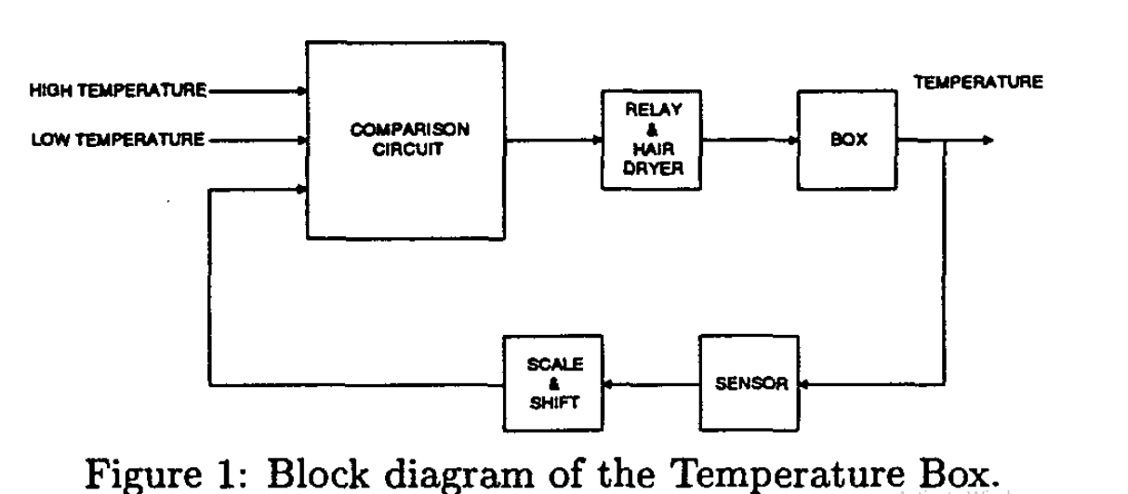
Md. Sajid Akbar
Introduction:

Slide 4
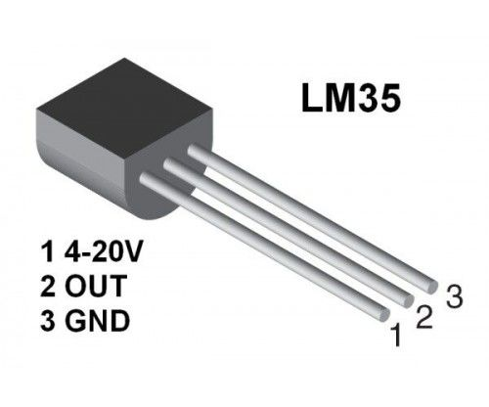
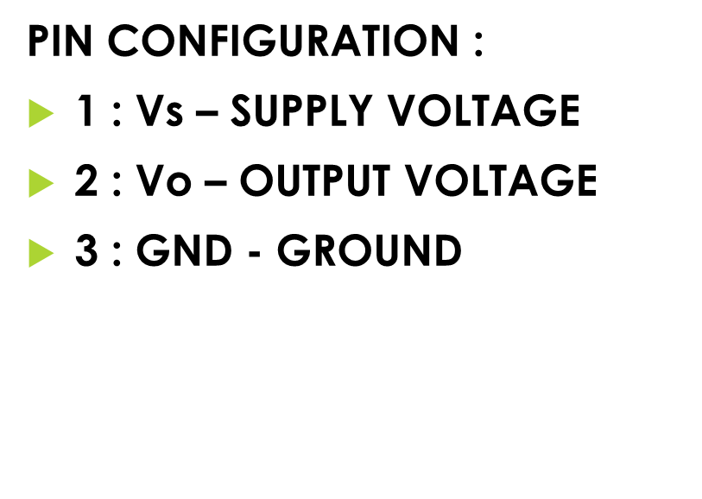
Sensor : LM35
Md. Sajid Akbar

Slide 5
Md. Sajid Akbar
READINGS FROM THE SENSOR
CELSIUS (°C) | FAHRENHEIT (°F) | VOLTAGE (Vs) (V)
24 | 75.2 | 0.27
25 | 77 | 0.28
26 | 78.8 | 0.29
27 | 80.6 | 0.30
28 | 82.4 | 0.31
29 | 84.2 | 0.32
30 | 86 | 0.33
31 | 87.8 | 0.34
32 | 89.6 | 0.35
33 | 91.4 | 0.36
34 | 93.2 | 0.37
35 | 95 | 0.38

Slide 6
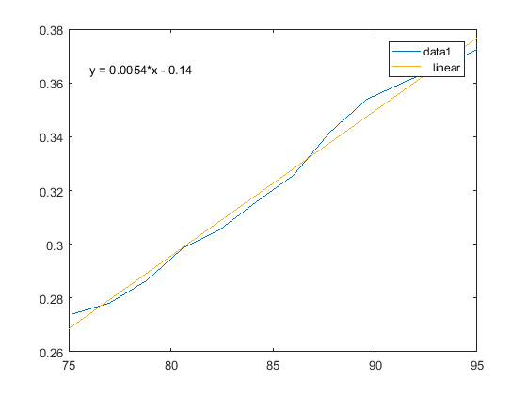
GRAPH AND EQUATION
EQUATION FROM MATLAB GRAPH :
y= -0.1369+0.005407*TF
Nusrat islam

Slide 7
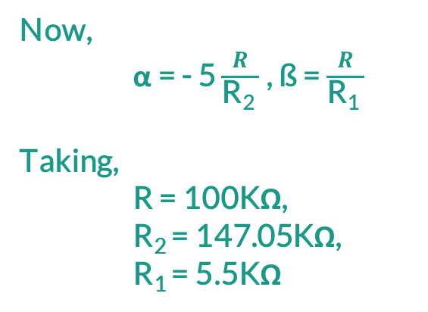
SCALE AND SHIFT REGISTER
1
Assumption of V_{T} : 75.2° F →1.5V
95° F → 3.50V
So, V_{T} = α + ßV_{S}
When, V_{T} = 1.50V, V_{S} = 0.27V
V_{T} = 3.50V, V_{S} = 0.38V
So, α = -3.40,
ß=18.18
Now,
α = - 5 $\frac{R}{\text{R}\text{2} }$ , ß = $\frac{R}{\text{R}\text{1} }$
Taking,
R = 100KΩ,
R₂ = 147.05KΩ,
R₁ = 5.5KΩ
Nusrat Islam

Slide 8
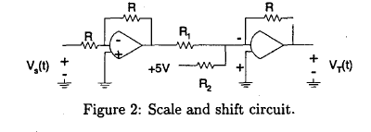
SCALE AND SHIFT REGISTER
Palash Chandra Ghosh

Slide 9
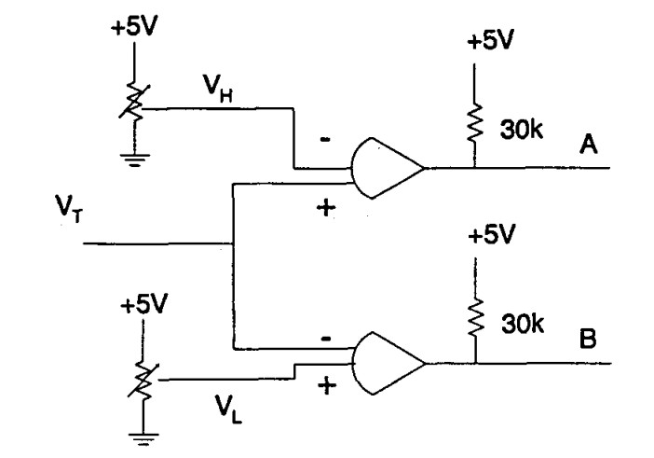
COMPARISON CIRCUIT
Adjustable Register
Fixing VH & VL
Takes Reference voltage
Compare reference voltage
VH = 3.7 V V L = 1.23 V
Fig: Comparison Circuit
Rayed Md Muhaymin Hasan

Slide 10
COMPARISON CIRCUIT
Conditions For the Comparison Circuit:
Conditions | A | B
VT < VL | 0 | 1
VL < VT < VH | 0 | 0
VT > VH | 1 | 0
Rayed Md Muhaymin Hasan

Slide 11
DIGITAL LOGIC CIRCUIT
Truth Table
Voltage Comparison
A | B | RK | RK+1
0 | 0 | 0 | X
0 | 0 | 1 | X
0 | 1 | 0 | 0
0 | 1 | 1 | 0
1 | 0 | 0 | 1
1 | 0 | 1 | 1
1 | 1 | 0 | 0
1 | 1 | 1 | 1
A | B | Voltage Comparison | Relay
1 | 0 | VT ≤ VL < VH | ON
1 | 1 | VL < VT < VH | No change
0 | 1 | VL < VH ≤ VT | OFF
Mehrab Azam Khan

Slide 12
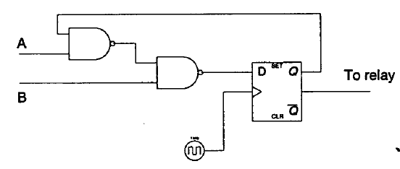
IMPLEMENTATION WITH D-FLIPFLOPS
D flip-flop is also known as transparent flip-flop cause next state always follows D .
Utilizes the logic to control relay
Characteristics Table :
Here , R_{K+1} (Relay’s next state) is implemented with 2 NAND gates and a D Flip-flop
(AQ)’ | [(AQ)’.B]’ | D
0 | 0 | 0
0 | 1 | 1
1 | 0 | 0
1 | 1 | 1
Figure: Sequential digital logic for comparison block.
Md Rezuwan Hassan

Slide 13
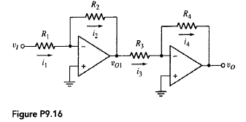
AMPLIFIER
Inverting amplifier used to get desired value
Connected to two resistors of op-amp
Op-amp connected to relay circuit
Relay does not work when value is -3V
Md Rezuwan Hassan

Slide 14
INVERTING AMPLIFIER
Input and output are out of phase by 180 degrees
Have higher gain
Vin shifted from -3V to 8V
It also provides virtual ground due to which input impedance is high which helps us to get desired value
Md Rezuwan Hassan

Slide 15
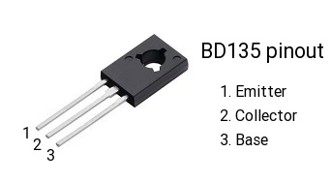
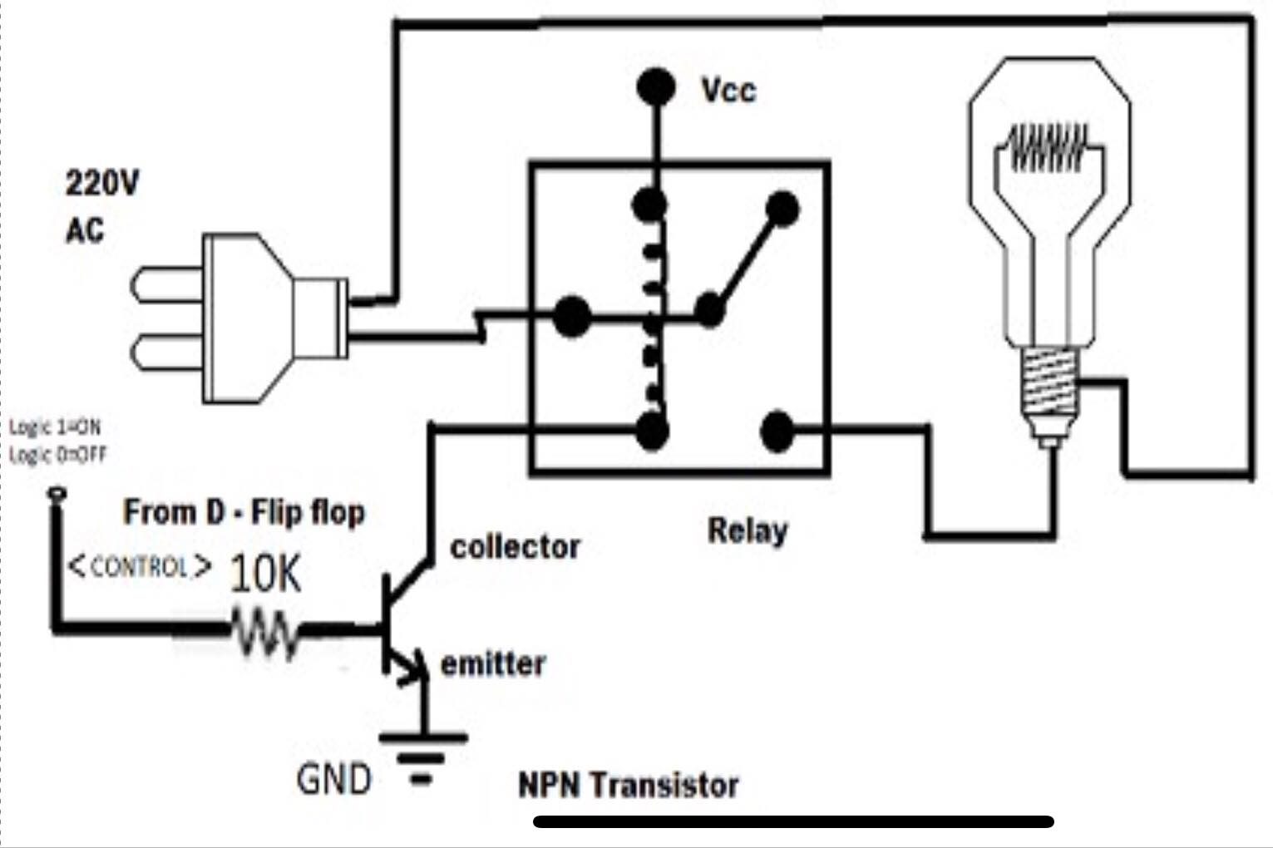
RELAY and BJT
Relay states depend on the output of the logic circuit.
BJT acts as a switch to magnetize the relay coil.
Output of flip-flop connected to base of BJT.
One point of Bulb is connected to NO pin of relay.
Tanjil Ahmed

Slide 16
THANK YOU

